Slide 1
Objectives
Learn the history of JavaScript
Create a script element
Write text to a Web page with JavaScript
Understand basic JavaScript syntax
Declare and work with variables
Learn about JavaScript data types

Slide 2
Objectives
Create and call a JavaScript function
Access an external JavaScript file
Add comments to JavaScript code
Learn about basic debugging techniques and tools

Slide 3
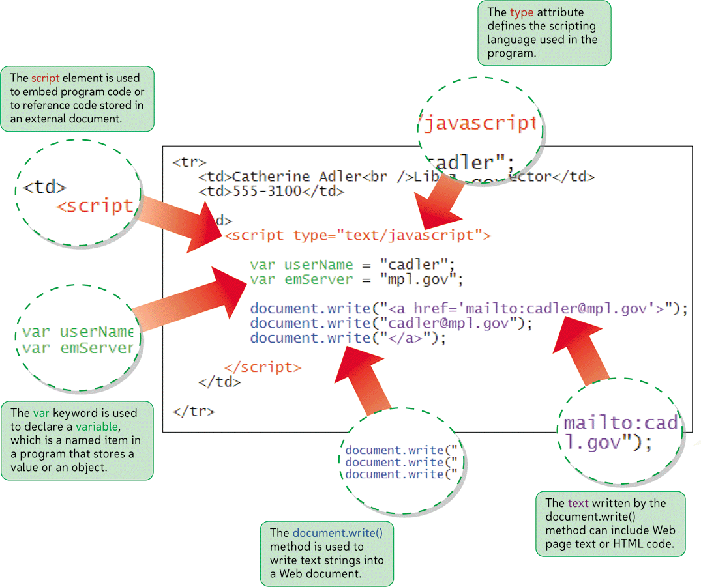
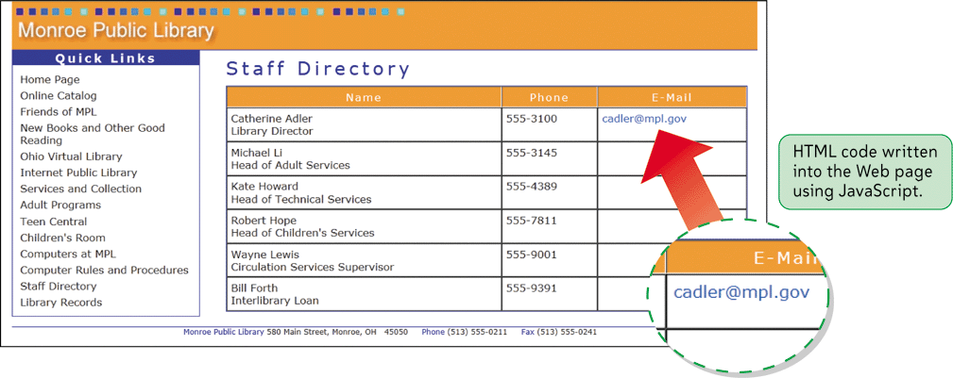
Using JavaScript Variables

Slide 4
Introducing JavaScript
Spam is essentially junk e-mail—messages that advertise products and services not requested by the recipient
A spammer is a person who sends these unsolicited e-mails, sometimes in bulk
An e-mail harvester is a program that scans documents, usually Web pages, looking for e-mail addresses

Slide 5
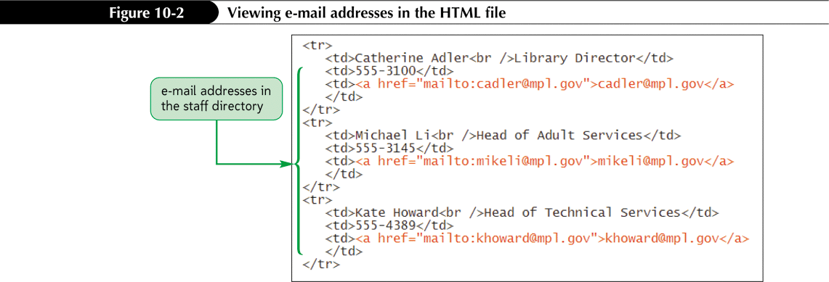
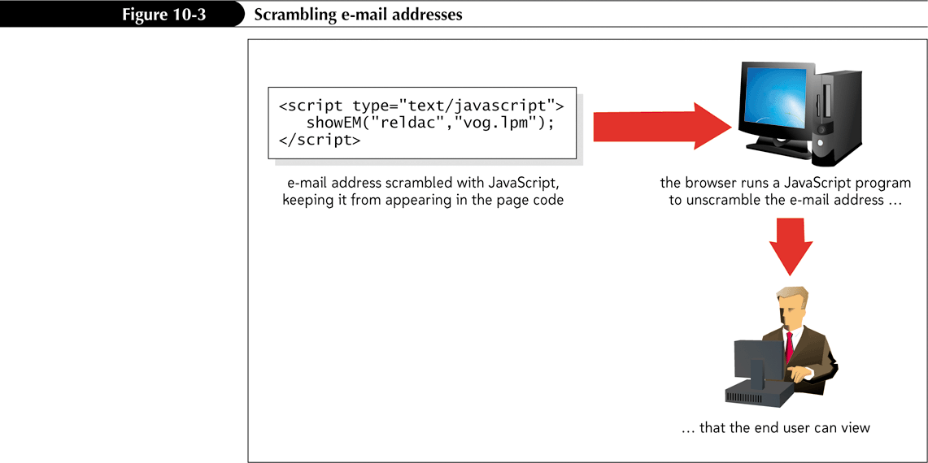
Introducing JavaScript

Slide 6
Introducing JavaScript
Server-side programs are placed on the server that hosts a Web site
Can be problematic
Client-side programming runs programs on each user’s computer

Slide 7
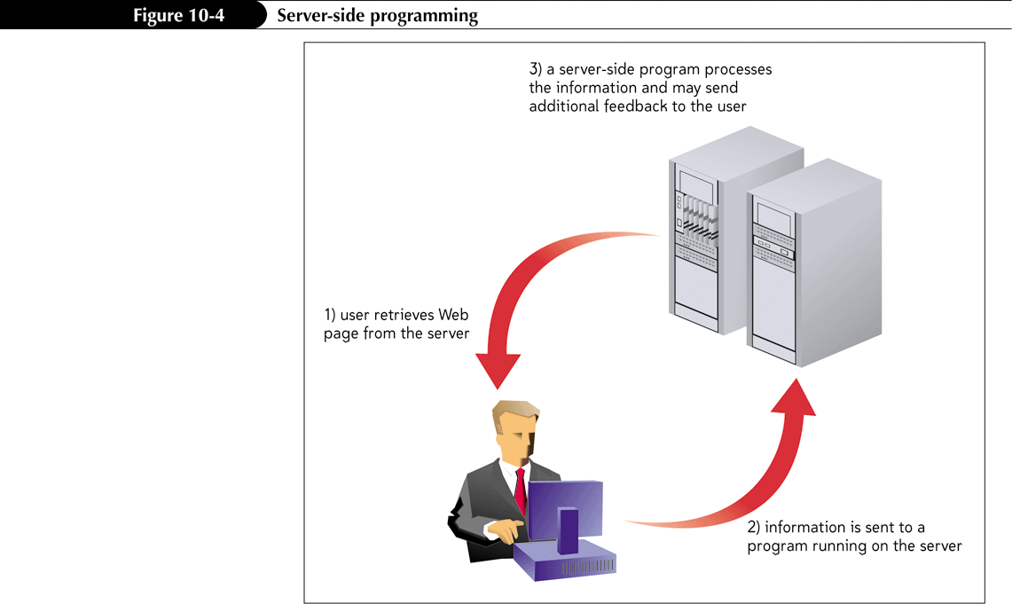
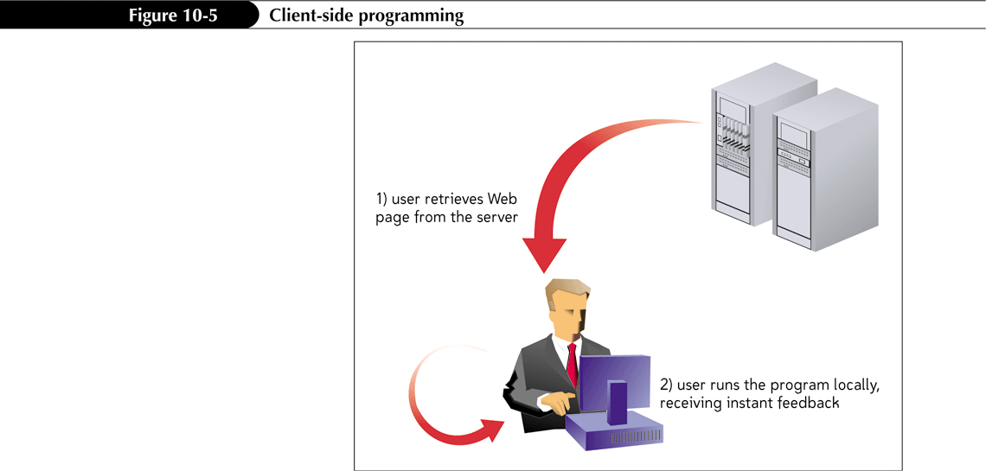
Introducing JavaScript
Server-Side Programming
Client-Side Programming

Slide 8
The Development of JavaScript
JavaScript is a subset of Java
Differences between Java and JavaScript:
Java is a compiled language
JavaScript is an interpreted language

Slide 9
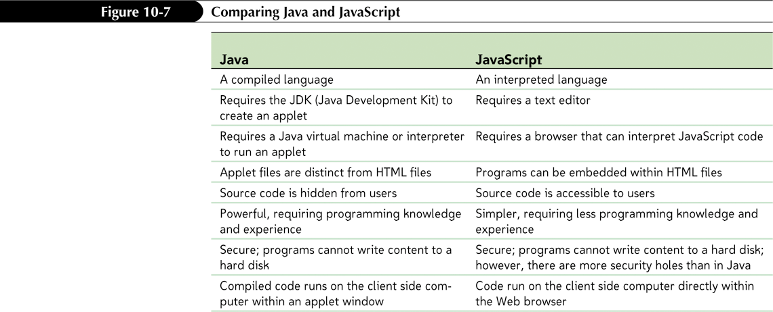
Comparing Java and JavaScript

Slide 10
Working with the script Element
A JavaScript program can be placed directly in an HTML file or it can be saved in an external text file
Insert a client-side script in a Web page when using the script element
<script type="mime-type">
script commands
</script>

Slide 11
Embedding a Script
To place a script element in a Web page, insert the two-sided tag
<script type=”mime-type”>
script commands
</script>
where mime-type defines the language in which the script is written and script commands represents commands written in the scripting language
For JavaScript programs, set mime-type to text/javascript.

Slide 12
Working with the script Element
Every JavaScript program consists of a series of Statements
Each statement—also known as a command—is a single line that indicates an action for the browser to take

Slide 13
Writing Output to a Web Document
An object is any item—from the browser window itself to a document displayed in the browser to an element displayed within the document
A method is a process by which JavaScript manipulates or acts upon the properties of an object

Slide 14
Writing Output to the Web Page
To write text to a Web page with JavaScript, use the method
document.write(“text”);
where text is the HTML code to be written to the Web page

Slide 15
Understanding JavaScript Syntax
JavaScript is case sensitive
Ignores most occurrences of extra white space
Do not break a statement into several lines
The + symbol used in this command combines several text strings into a single text string

Slide 16
Working with Variables
A variable is a named item in a program that stores a data value
You introduce variables in your code by declaring them
Declaring a variable tells the JavaScript interpreter to reserve memory space for the variable

Slide 17
Declaring a JavaScript Variable
To declare a JavaScript variable, use the statement
var variable;
where variable is the name assigned to the variable.
To declare a JavaScript variable and set its initial value, use
var variable = value;
where value is the initial value of the variable.

Slide 18
Working with Data Types
JavaScript data types:
Numeric values
Text strings
Boolean values
Null values
You must declare a variable before using it

Slide 19
Working with Data Types
Numeric value is any number, such as 13, 22.5, -3.14159 etc.
Can also be expressed in scientific notation
Text string is any group of text characters, such as “Hello” or “Happy Holidays!”
Must be enclosed within either double or single quotations (but not both)
Boolean values accept only true and false values
Null value has no value at all

Slide 20
Working with Data Types
JavaScript is a weakly typed language
The + symbol can be used with either numeric values or text strings
var total = 5 + 4;
var emLink = "cadler" + "@" + "mpl.gov";

Slide 21
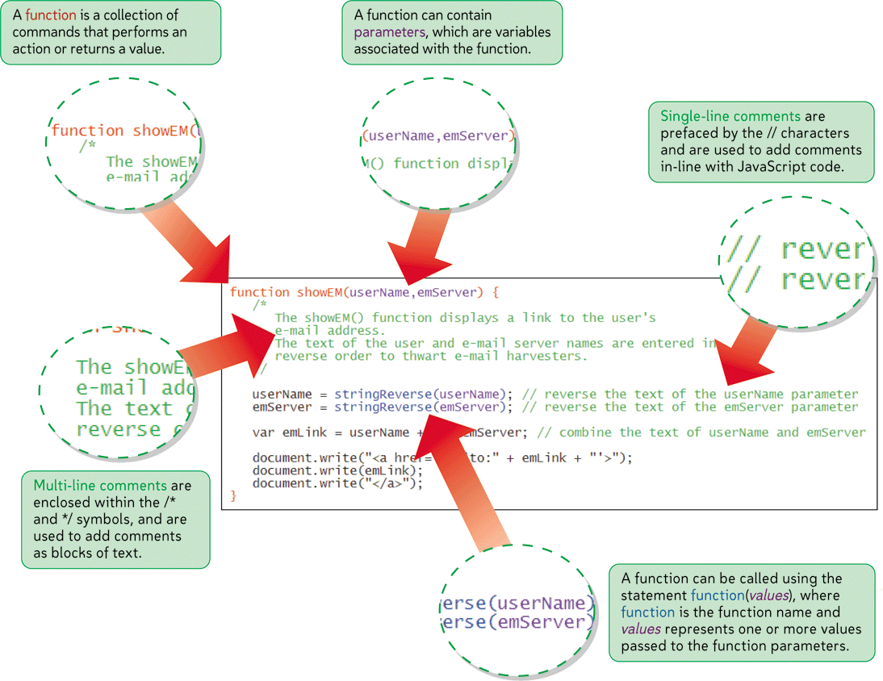
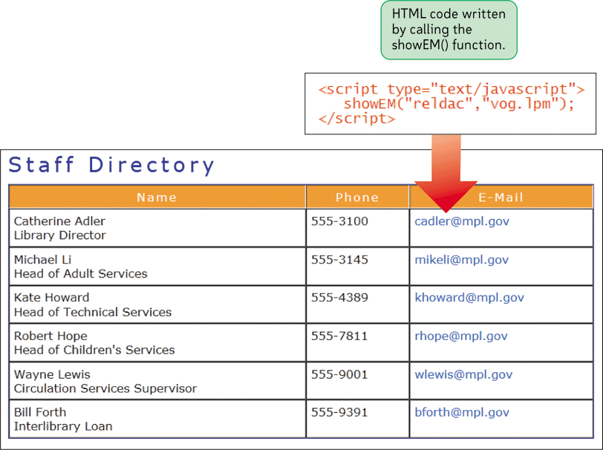
Writing JavaScript Functions

Slide 22
Creating a JavaScript Function
A function is a collection of commands that performs an action or returns a value
A function name identifies a function
Parameters are values used by the function
The function is executed only when called by another JavaScript command
function_name(parameter values)

Slide 23
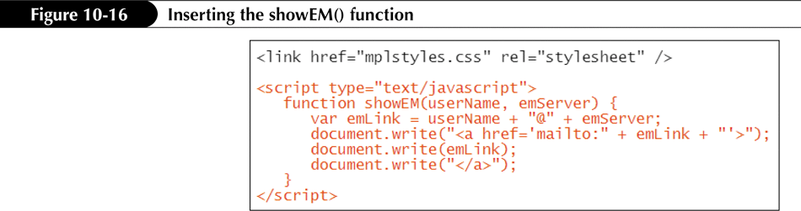
Creating a JavaScript Function

Slide 24
Creating and Calling a JavaScript Function
For a function to return a value, it must include a return statement
function function_name(parameters){
JavaScript commands
return value;
}

Slide 25
Accessing an External JavaScript File
The code to access an external script file is:
<script src="url" type="mime-type"></script>
to the Web page, where url is the URL of the external document and mime-type is the language of the code in the external script file.
For JavaScript files, set the mime-type to text/javascript.

Slide 26
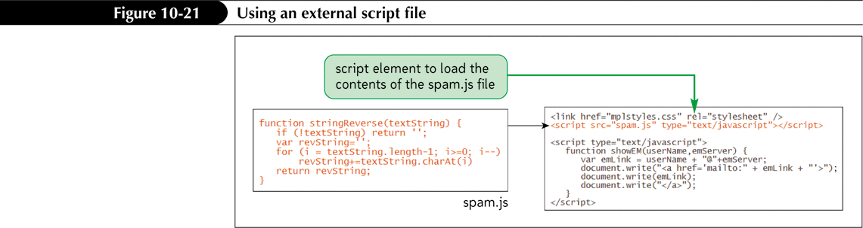
Accessing an External JavaScript File

Slide 27
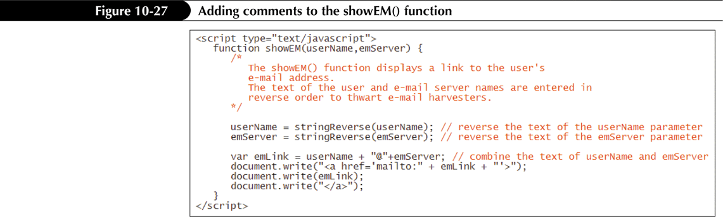
Commenting JavaScript Code
Commenting your code is an important programming practice // comment text

